Slide 1
YOUR SKILLS AS A TICKET TO EMPLOYABILITY!
We have added all the information you need during the workshop in the Notes section of the PowerPoint.

Slide 2
Session about your skills
xxh - xxh40 : Your skills
Research about the skills of an Arts student
Explore your skills profile
What does your personal skills profile mean?
xxh40 - xxh55: Break
xxh55 – xx+2h: Activities
Peer reflection
Collect your statements
Notes:
Workshop of 2 hours.
We added a break, so that students who need more time to fill in the survey can do so during the break.
Different possible configurations:
Ask students to fill in the profile test in advance (i.e. 20 minutes less).
Omit the break (i.e. 15 minutes less).
Only do one activity (i.e. 30 minutes less).

Slide 3
Your skills

Slide 4
The skills of an Arts student?
?
?
?
?
?
?
The ASSET-H skills profile for Arts students.

Slide 5
Skill Profile: research-based
Pilot studies at KU Leuven
Bottom-up approach (questionnaire with open fields)
Quantitative analysis of large-scale questionnaire
List of concrete, meaningful descriptions of skills specific to students in the Faculty of Arts at KU Leuven (“Arts Profile")
Notes:
Need more information?: https://www.assethproject.eu/post/a-humanities-skills-profile-as-a-ticket-to-employability

Slide 6
Skill Profile: research-based
Pilot studies at KU Leuven
ASSET-H
Looking for specific skills for Arts students across Europe
Questionnaire among 1306 Arts students and a control group of 231 non-Arts students
Output = detailed skills profile
Notes:
Need more information?: https://www.assethproject.eu/post/a-humanities-skills-profile-as-a-ticket-to-employability

Slide 7
Arts skills profile
Knowledge & Information
Language
Project
Creativity
Interculturalism
Communications
Notes:
This is the output of our analyses, namely 6 skills clusters: knowledge, communication, language, project, creativity and interculturality.
[The following slides have the name of the cluster on the left side, the description of the cluster in the middle, and an example item in the blue rectangle].

Slide 8
KNOWLEDGE & INFORMATION
Arts students expertly handle and manage information and knowledge in a four-step process:
Finding the right information to solve a problem;
thinking about it by distilling the abstract from the concrete;
synthesize, reducing large amounts of information to its essence;
Formulate findings in the most appropriate manner

Slide 9
KNOWLEDGE & INFORMATION
item 36
"I can interpret results from research."
item 66
"I can bring together information from different sources into a whole."
item ...
...

Slide 10
COMMUNICATION
Excellent communication skills enable Arts students to collaborate and lead.

Slide 11
COMMUNICATION
item 75
"I have the right communication skills to take on a leadership role."
item 71
"I can select an appropriate communication channel for my message."
item ...
...

Slide 12
LANGUAGE
Arts students are proficient in language because of their deep understanding of how languages work.

Slide 13
LANGUAGE
item 18
"I am above average in at least one language."
item 13
"I pay attention to how language varies, functions and changes in my environment."
item ...
...

Slide 14
PROJECT
Excellent organizational skills enable Arts students to complete their projects in a timely and successful manner.

Slide 15
PROJECT
item 98
"I can break down a task into achievable subtasks."
item 93
"I can manage my own work when working on a project that runs over a longer period of time (e.g., several months)."
item ...
...

Slide 16
CREATIVITY
Arts students have an artistic side and thus have a knack for coming up with new and innovative ideas.

Slide 17
CREATIVITY
item 107
"I can think out of the box to come up with new ideas."
item 108
"I have a great imagination."
item ...
...

Slide 18
INTERCULTURALITY
Arts students cultivate open-mindedness and empathy through deep reflection.

Slide 19
INTERCULTURALITY
item 46
"I realize that there is more than black and white: I can also think 'gray'."
item 43
"I am open to the thinking of others."
item ...
...

Slide 20
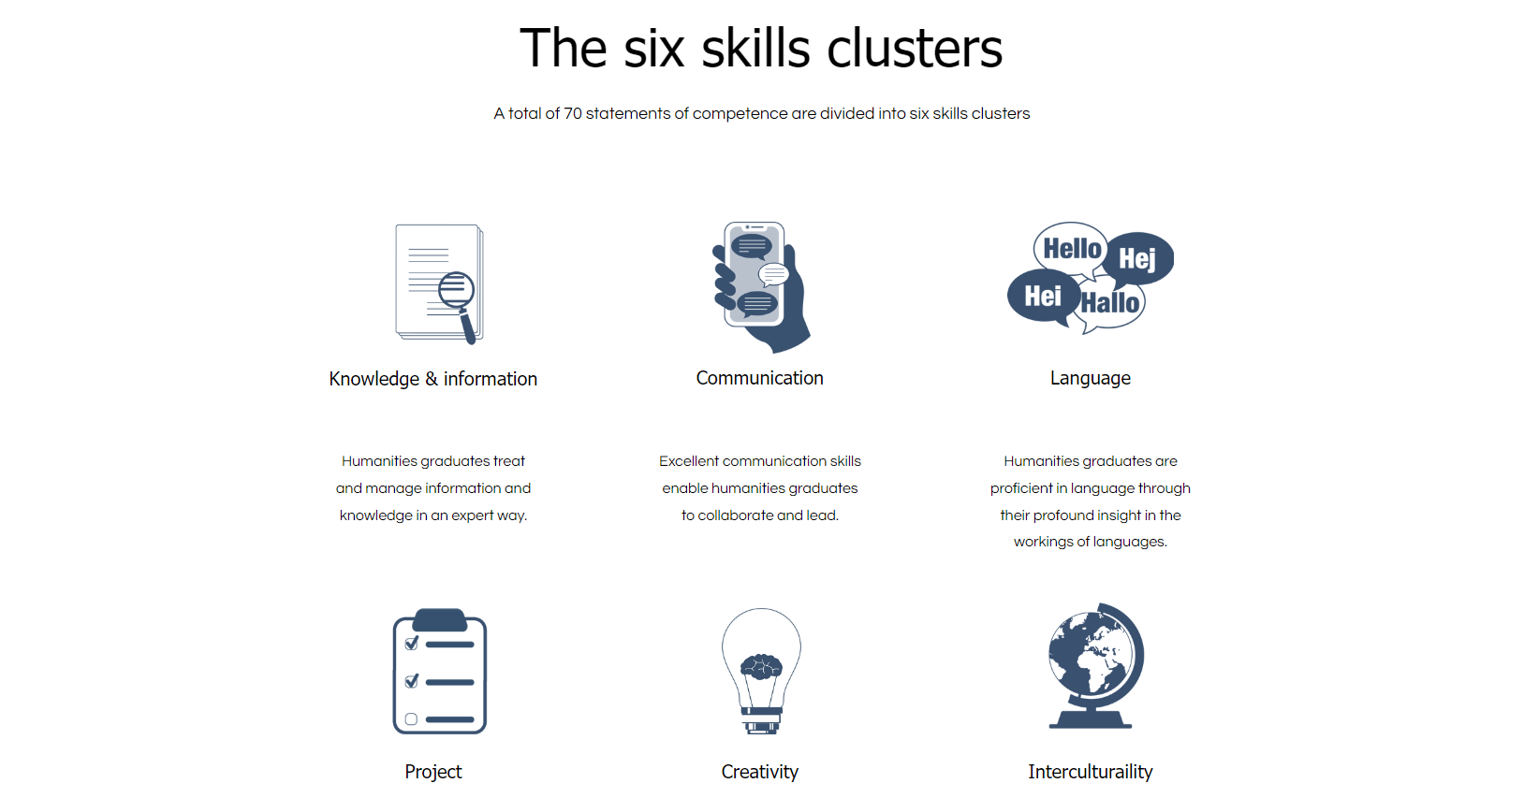
www.assethproject.eu
* ISCED group 22, including history, archaeology, art, musicology, linguistics, literature, religion and philosophy
www.assethproject.eu
Notes:
A full overview of the skills clusters, descriptions and specific skills items can be found on the ASSET-H website. On this website, we use the term “Humanities” to refer to the ISCED group 22.

Slide 21
www.assethproject.eu

Slide 22
H-You: Humanities Explorer
Tool to prepare you for the job market, with a focus on skills
Activities > Explore your Humanities profile
Your personal profile
Discover what traits, talents and skills set you apart from other Arts students.
Notes:
Based on this research, the ASSET-H team developed the H-You Humanities Explorer. This tool consists of several activities for students to prepare them for the job market, with a focus on skills.
More information and link to the tool: https://www.assethproject.eu/h-you
First activity we’ll discuss in this workshop: Explore your Humanities profile.

Slide 23
Why?
Meets a need for:
HR professionals: Arts profile is sought-after and future-oriented, but (self-)awareness is often lacking
Students themselves indicate that they lack the "language" to express what they feel strongly about
Awareness leads to communication about your skills in a detailed way
More than "critical thinking" and "good with texts"!
The ideal preparation for interviews and job interviews
Notes:
Critical thinking → You can a critical thinking in several ways and it helps to make that very concrete, e.g., during the synthesis of large amounts of information or when analyzing data.
Good with texts → You can be good with texts in several ways, e.g. reading, writing, synthesizing texts.

Slide 24
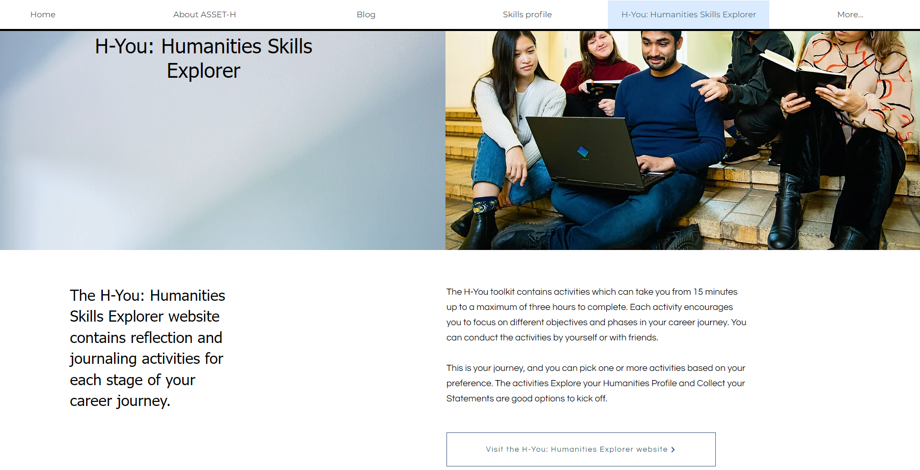
www.assethproject.eu
www.assethproject.eu
Notes:
https://www.assethproject.eu/h-you

Slide 25
H-You: Humanities Explorer
Notes:
https://www.assethproject.eu/h-you

Slide 26
H-You: Humanities Explorer
Notes:
Invite them to fill in the survey at this point.
If you use the H-You: Humanities Explorer tool, make sure to ask participants to bring their own laptop. You can also fill it in on smartphones, although the experience on a laptop is better.
https://www.assethproject.eu/h-you
In the methodological toolkit, there is also a print-out version available of the survey.
https://www.assethproject.eu/h-you-methodological-toolkit

Slide 27
What does the result mean?
Core areas
Showcase these on the job market. These are the skills you can highlight!
Definitely keep developing that skill so that you really become an expert at it.
Development areas
Still room to develop further
Think about it the next time you have to choose a particular subject, major or hobby.
You can't be good at everything! Don't just focus on the lower scores and don't be discouraged by them.

Slide 28
What does the result mean?
Self-perception does not say everything
You have had to judge for yourself what your skills are like. So this is not an absolute reflection of your objective skills.
Above all, this tool wants to help you reflect.
Very negative everywhere? Been too critical of yourself? Do the exercise together with someone you know?
Very positive everywhere? Look at the nuance differences. In which of these skills do you excel at a bit more than the others? Showcase these! Which ones a bit less? You can develop those skills further.

Slide 29
Break
Notes:
Students who are not finished with filling in the survey, can do so during the break.

Slide 30
The activities

Slide 31
The next step?
Learn to better understand and articulate your unique skills profile so that you have a better view of your unique skills.
→ an ideal basis for cover letters and job interviews

Slide 32
H-You: Humanities Explorer

Slide 33
Why reflect?
Arts students have many common denominators, but you are also a diverse audience
Different study paths, interests, ...
Giving ready-made answers about which job fits which profile is difficult and not desirable
Purpose → start to reflect on your profile and how it relates to the job market

Slide 34
"Perceived employability"
= the individual's perception of his/her available employment opportunities
People take into account both individual skills and contextual factors (e.g. labor market trends).
Perception largely determines behavior ➔ people only pursue the opportunities they see.
Reflection allows new possibilities to become visible.

Slide 35
Where do you want to work?
THEORY OF FIT
fit vertically Does the employee's level of education match the level required for a particular job?
fit horizontally Does the job field match the degree?
fit competencies Are the competencies, acquired in degree, needed for the job?
fit person environment Does the organizational culture of the company/organization match the employee's personality?
Top three desired sectors:
Cultural sector
Media
Education
BUT cf. the theory of "fit" makes it clear that the horizontal fit is not the only possible fit....
- vertical fit
- competencies (!)
- person-environment
Notes:
In order to make the reflection a bit easier, we incorporated this slide. This might inspire students to change their perspective and ways of thinking about the labour market.
We have done a survey at KU Leuven Faculty of Arts, and asked students about the sectors they want to work in. Humanities students appear to view the sectors in which they want to enter as very limited:
Cultural sector
Media
Education
From the survey, we cannot deduce exactly why students put forward exactly these sectors - however, one can suspect that they are sectors that are very eye-catching and have some kind of natural appeal for Literature students. At first glance, these work field domains align very closely with Arts - In the theoretical model of the "fit" (or the connection between competencies and work field), this is called a "horizontal fit.
However, it is very important to also think about the other possible 'fits' when transferring to the job market and decide for yourself what carries weight.
Vertical fit: when companies require applicants to have a university degree, but it does not matter what kind of degree. This often means that they need someone with a certain amount of analytical or logical thinking. Example sectors/jobs: government, consultancy (e.g. master's degree in Social sciences)
Competency fit: Look for a fit between the competencies you are good at and enjoy doing, and the competencies needed in a job. For example, interculturalism very important? Then consider large international players in logistics where you are in daily contact with different nationalities and cultures. For example, knowledge processing and communication very important? Then consider a job as a data analyst in the IT sector, where you have to translate customer needs for programmers and translate the programmers' findings to customers.
Person-environment fit:
Does the culture of the organization match your desired culture? E.g. 9 to 5 mentality (found more in, for instance, public services), or work hard play hard mentality (found more in, for instance, consultancy)?
If there are certain aspects in your personal life you are passionate about, you could consider finding a job that integrates that. Diversity or equality very important? Then consider jobs as diversity officer at cities, diversity organizations. Youth work important? Then consider a job at the umbrella body of a youth movement.
Conclusion: There are lots of opportunities for you out there, depending on your interests. First step: reflecting about your profile and desired jobs.

Slide 36
Peer reflection

Slide 37
Peer reflection
In this exercise, you will exchange your skills profile with a fellow student and perform some reflection steps together to better understand the meaning of your profile through comparison and feedback. → 2 to 3 students
The goal is to deepen your understanding of your skills profile and inspire and motivate each other to continue on your career journey.
Tight timing!
Notes:
Use the “peer reflection” activity description in the H-You tool, or in the methodological toolkit, to facilitate this activity. Ask students to sit together in groups of 2-3 students and guide them through the exercise step by step.
https://www.assethproject.eu/h-you-methodological-toolkit
https://www.assethproject.eu/h-you

Slide 38
Collect your statements

Slide 39
Collect your statements
In this exercise, you increase your self-awareness and profiling by creating short experiences that show how you used your skills in different situations.
You are going to link your skills to experiences to prove that you have that skill.
Skills: inspiration from our profile test (see report or website)
Experiences: not only work experiences, but general (studies, social life, ...)
You can use these in cover letters or when verbally expressing your experiences, for example during job interviews but also for more informal moments.
Notes:
Use the “Collect Your Statements” activity description in the H-You tool, or in the methodological toolkit, to facilitate this activity. Ask students to sit together in groups of 2-3 students and explain the activity to them. In the group session, it is best to ask them to start with ONE skill, and if they have time left, they can also do other skills. They can discuss the chosen skill and experience with their peers.
https://www.assethproject.eu/h-you-methodological-toolkit
https://www.assethproject.eu/h-you

Slide 40
Collect your statements
Start with one skill
If you still have time left, do the same exercise for other skills

Slide 41
What next?
Notes:
After this workshop, there are also other activities available for them to do: i.e., career connector and journaling.

Slide 42
What next?
Notes:
They can also go to the Career Stories section of the ASSET-H blog. In this section, Humanities alumni discuss how they use their skills daily in their current jobs.

Slide 43
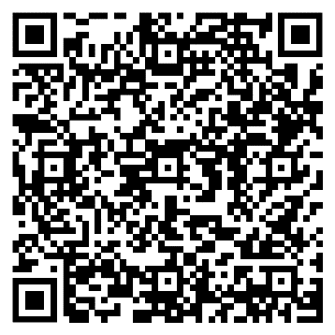
Thanks!
More information:
https://www.assethproject.eu/

