Slide 1






Slide 2
Intro
Nice to meet you!
Notes:
First, everyone briefly introduces themselves: their name, job, in which department they work, and on which course they would like to work on today.

Slide 3
ASSET-H
ASSET-H highlights the unique skills profile of Humanities graduates and helps students and the labor market to find each other
  Help university teaching staff align their courses with the overall profile of the Humanities
  Encouraging teachers to focus on skills when designing courses

Slide 4
Intro
Which Humanities skills do I want to teach my students in my course?
Starting point
for reflection!
Notes:
The main question that we want to deal with today: Which Humanities skills do I want to teach my students in my course?
The main goal of this workshop is for teachers to reflect on the skills of their profession and how to communicate them to students. The workshop acts as a starting point to reflect on this, and the intention is for the teachers to refine this further after the workshop. Thus, at the end of this workshop, the teacher will not have a fully worked out plan, but will have an initial idea of how to proceed with this.

Slide 5
Skills?
Intro
Output scientific research – see
ASSET-H knowledge clip
Knowledge
Language
Project
Creativity
Interculturality
Communication
Notes:
When we talk about skills in this workshop, we are talking about the 6 skills of the ASSET-H project. These skills together are the skills specific to Humanities students, and these are the output of scientific research. In the knowledge clip, you have already had a lot of information about this.
A few additional things we want to point out:
The cluster "knowledge" is not about having a lot of knowledge, but about the skills to efficiently process knowledge and information.
Language is more than just being able to speak different languages. It also includes being good at one language, and managing several registers in that language, for example.

Slide 6
Skills in the curriculum
Course x Skills?
Content
Learning activities
Knowledge
Language
Project
Creativity
Interculturality
Communication
Notes:
In this workshop, we will reflect about how you teach students skills with your course. You do that in two ways: through the content of the course, and the way in which you offer that content to students (i.e. the learning activities).

Slide 7
Skills in the curriculum
Course x Skills?
Content
Learning activities
Knowledge
Language
Project
Creativity
Interculturality
Communication
Notes:
An important point to emphasize here is that we are convinced of the inherent value of our courses, and that our disciplinary approach teaches students many skills. So, we start from what is already there, and we do not expect teachers to add additional or generic skills to their classes.
We give some examples of how the content of a subject can be used to teach students skills:
Language skills are not just something that students studying language subjects have. History students, for example, also acquire language skills by learning how to work with medieval sources, handle complex language materials such as academic texts, or use dictionaries. Similarly, our Art Science students are also language experts. They not only learn to interpret and write academic texts, but also have to learn to write popularizing brochures or content reports.
Our Area Studies students learn a lot about other cultures explicitly and implicitly in their lectures, making them experts in interculturalism skills.

Slide 8
Skills in the curriculum
Course x Skills?
Content
Learning activities
Knowledge
Language
Project
Creativity
Interculturality
Communication
Notes:
Secondly, you also have the way in which you teach students the content, which are the learning activities.

Slide 9
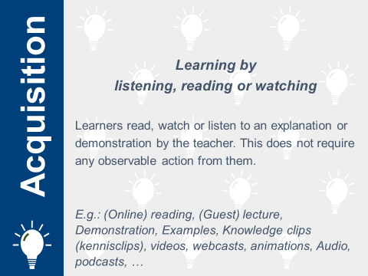
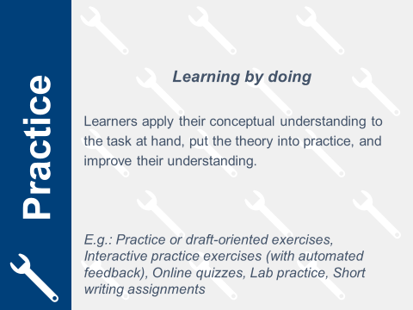
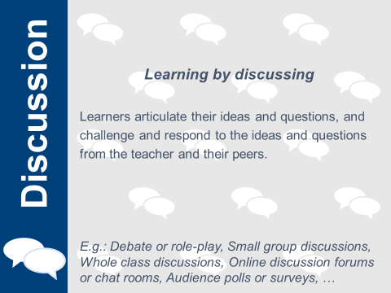

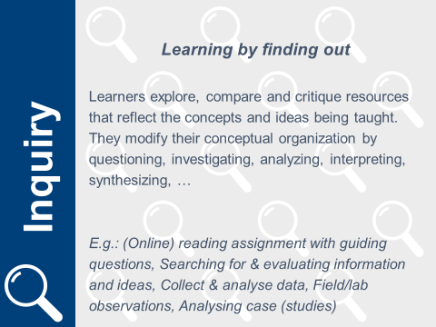
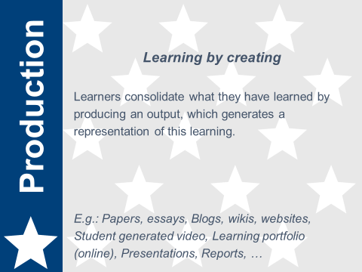
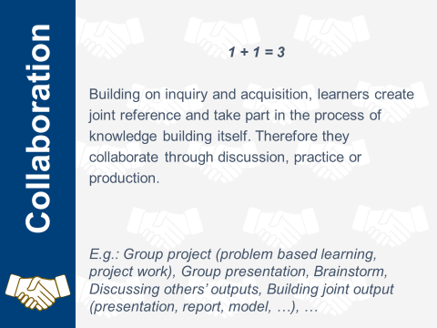
6 learning activities
Notes:
The 6 learning activities are based on the research of Diana Laurillard who states that following 6 learning activities are necessary to construct knowledge:
Acquisition: involves hearing, reading, viewing information - the student receives, but does not articulate the information.
Inquiry: the student engages with the content on their own - they explore, compare, question - in this phase the student refines their understanding of knowledge.
Practice: involves application, accompanied by feedback to adjust learning
Discussion: question and answer with teacher and/or fellow students
Production: the student converts their current understanding into a product, creates a representation of what they have learned
Collaboration: includes learning through discussion, practice and production; working together - this activity occurs in combination with others and forms an 'extra layer

Slide 10
Skills in the curriculum
Course x Skills?
Content
Learning activities
Knowledge
Language
Project
Creativity
Interculturality
Communication
COMMUNICATION
IS KEY
Notes:
A first step is for teachers to become explicitly aware of the skills they teach students by gaining insight into the content and learning activities of their subject. Teachers are often implicitly aware of this, but we want to make this knowledge explicit through this training.
Second step is that teachers also start communicating about this to their students. This communication is crucial so that our students also become aware of their skills and gain the self-confidence they need on the job market.

Slide 11
Approach
How? ABC design
Developed by University College London (UCL): Clive Young and Nataša Perović
  Based on research by Prof. D. Laurrilard
  Used all over Europe
Practice-based approach to (re)design of course
  From a student perspective
  In dialogue with colleagues
  Starting point
Laurillard, D. (2012). Teaching as a Design Science: Building Pedagogical Patterns for Learning and Technology. New York and London: Routledge.
Notes:
In this workshop we will use the ABC design, which was developed by University College London (UCL) by Clive Young and Natasa Perovic. They based this on research by Professor Laurrilard. This design is used all over Europe.
It is a hands-on approach to (re)design a course.
In this workshop you will be challenged to start from the student's perspective. In this workshop we try not to think from teaching format (what do I offer as a teacher?), but to step into students' shoes.
The enriching part of the workshop is the conversation you enter into about your course. ABC offers you a common language to talk about the concrete approach of your course and to enter into a dialogue with fellow teachers.
Finally, we want to emphasize again that this workshop is a starting point. You will go home with new ideas about your teaching approach, which you can then develop further.

Slide 12
Approach
ABC design
Start page (20’)
Story board (50’)
Action plan (10’)
Feedback (20’)
Strict timing!
Notes:
The workshop will look like this. There is a tight timing attached to each step so that we can go through the full design process. This may cause some teachers to get a little stressed. Above all, keep in mind that this workshop serves as a starting point. After today, you can start working with the ideas to think them out further. It does not have to be perfect after today.
The most important thing is to have a dialogue through each phase: exchange and critically question each other.

Slide 13
Approach
Two options of how to participate in
this workshop
On paper?
Using an interactive powerpoint?
Can be found in the email with the preparation for this session
Notes:
You have the choice of doing the assignments on paper or in the interactive PowerPoint. It is best that you explain that the choice of paper is the best choice for teachers who like to work with pen and paper, and who like a hands-on approach. Choosing the Interactive PowerPoint is better when teachers like to work digitally. In addition, the PowerPoint also has the advantage that teachers can easily modify their new design at a later time. This is also possible with the paper version, but it is a bit more difficult.
If you have teams of teachers who want to work together on the same course, it is best if they choose the same format.
Once everyone has made a choice, you can have the participants sit together in groups of 2-4 people. It is important that you get people to sit together with the same decision (paper or PowerPoint).

Slide 14


Start Page

Slide 15
Start page
Start page = setting the scene
  Information pages to help you refresh your memory
    Skills
    Learning activities
  Paper: look at paper “start page”
  Powerpoint: slide 3
Notes:
The facilitator indicates that with this start page we will map the situation as it is now.
If there are teachers among them who want to develop a new course, you can give them the task of mapping out their ideal situation.
The facilitator indicates that the teachers need not dwell too long on these questions, and that it is rather a rough estimate of what the course will look like. It will serve as a starting point, but also no more than that.
If, while making the start page, you don't remember what skills or learning activities are, you can always look at the information pages.

Slide 16
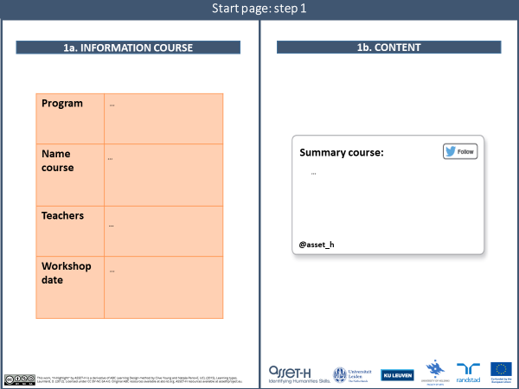
Notes:
As a first step, they fill in the information of the course, and the content of the course (5'):
Add information of the course: this may be very brief as it serves mainly as a reminder for the teacher.
Content: you ask the teachers to summarize in one sentence the content of their course. This assignment is called "tweet your module", and so you ask teachers to summarize their course in the number of characters of a tweet. This description will probably not be able to summarize the entire course, but it will be able to summarize the core content of the course.
For those who work with the interactive PowerPoint: if you click on the three dots you can start typing there.

Slide 17
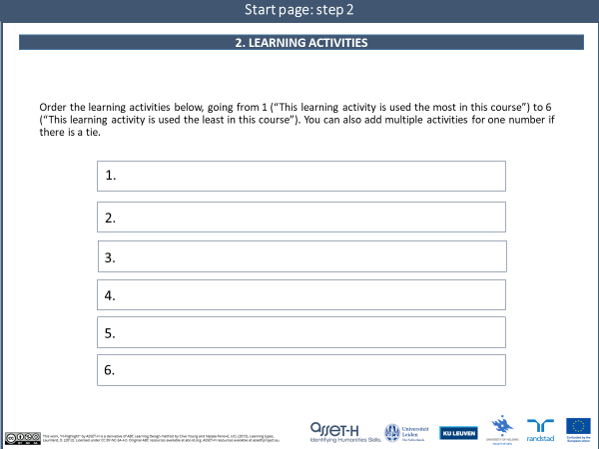
Notes:
As a second step, they indicate the learning activities on a ranking scale (5').
Rank the learning activities below, ranging from 1 ("This learning activity is used the most in this subject.") to 6 ("This learning activity is used the least in this subject."). You can also add multiple activities for one number when there is a tie.

Slide 18
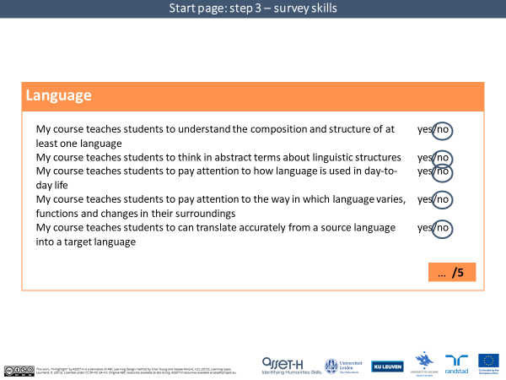
Notes:
As a third step, they complete the survey on the skills of their course and summarize their scores on the chart at the end of the survey (10').
We do not distinguish between teaching weeks and evaluation in the survey. Thus, it is not the case that teachers must also formally question those skills in an evaluation (e.g., an exam or an exam paper) in order to teach them to students.
If there are teachers among them who do not teach languages, it is also helpful to mention in the survey for "language" that they may interpret this broadly. For example, this should include teachers teaching students different registers (such as academic or journalistic language).
For those who work with the interactive PowerPoint: you can move the red circles around.

Slide 19
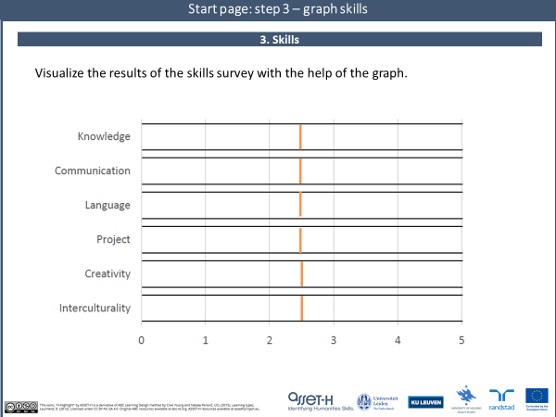

Slide 20

Start Page

Slide 21
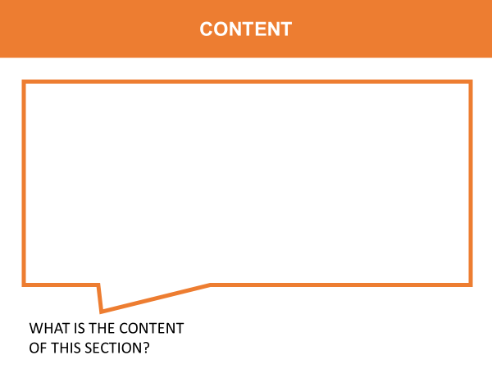

Story board
Start page
Story board
! Transition between current and ideal situation
  Structure: Write down the structure of your course on the story board (according to chapters, online contact, lecture - practice session, ..)
  Content:
    Paper: write down the content of each part on a content card
    PowerPoint: write down the content of each part on the content field

Slide 22
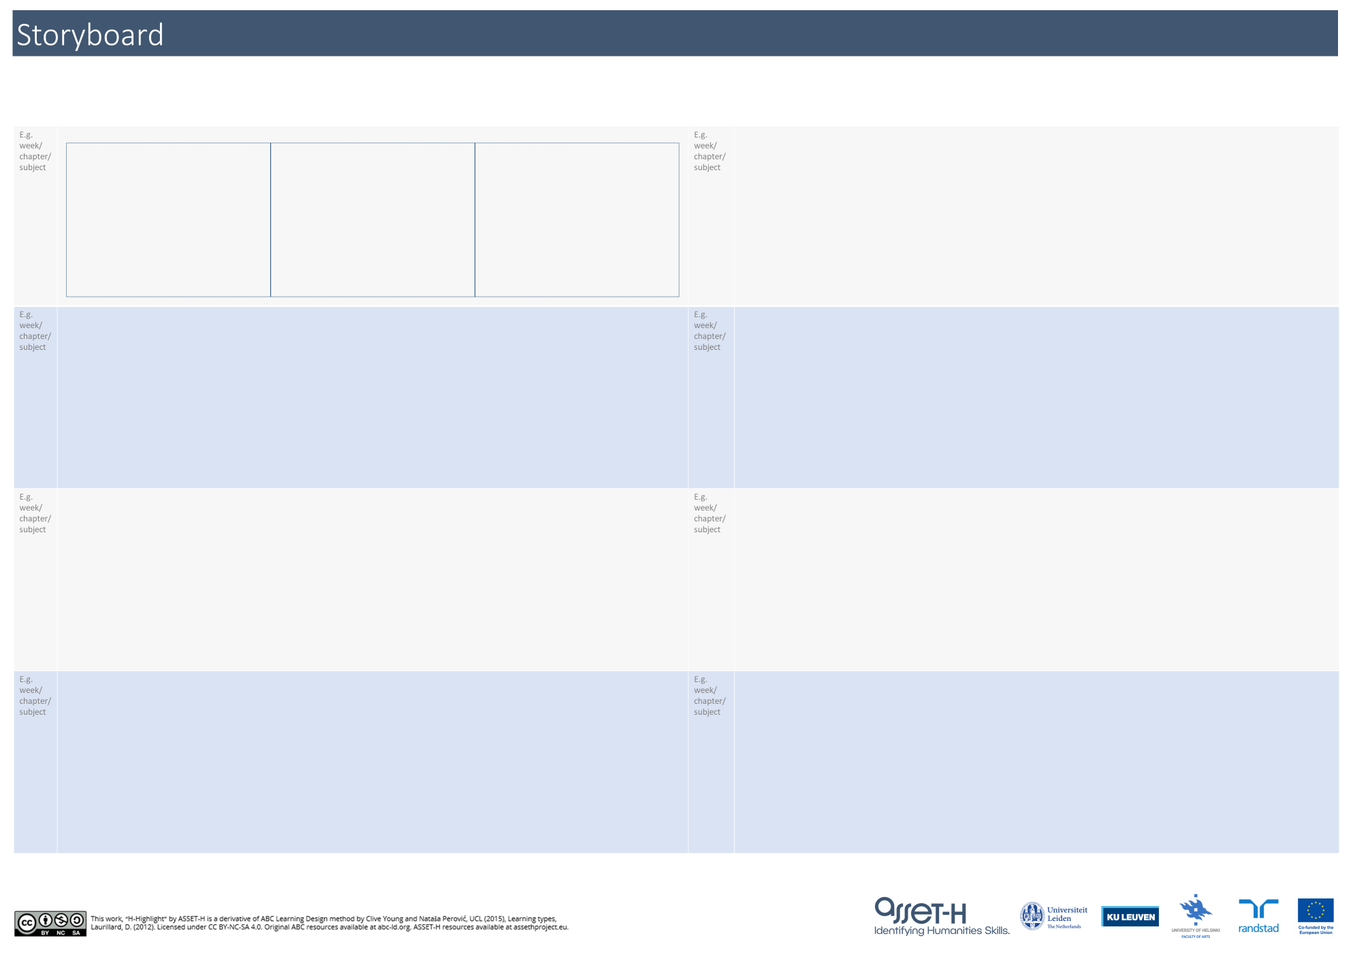
Notes:
This is the story board for those who are working on paper. The left side is to write down the structure.

Slide 23
THEORETICAL
PRACTICAL
Week 1
Week 5
Week 2
Week 6
Week 3
Week 7
Week 4
Week 8
Notes:
This is an example of a teacher. His subject has two parts, namely a theoretical and practical part of his subject. Each part has 4 teaching weeks.

Slide 24
THEORETICAL
PRACTICAL
Week 1
Week 5
Week 2
Week 6
Week 3
Week 7
Week 4
Week 8
Notes:
For each part of the course, you add a content card.

Slide 25
THEORETICAL
PRACTICAL
History
Old Methods
Week 1
Week 5
Week 2
Variation
New Methods
Week 6
Change
Advanced New Methods
Week 3
Week 7
Implications
Research paper
Week 4
c
Week 8
Notes:
On each content card, you add the content of that card.

Slide 26
Story board
BUILDING BLOCKS
CONTENT |  | LEARNING ACTIVITY | SKILLS
…
ACQUISITION
ACQUISITION
INQUIRY
INQUIRY
DISCUSSION
DISCUSSION
PRODUCTION
…
PRODUCTION
PRACTICE
PRACTICE
COLLABORATION
COLLABORATION
KNOWLEDGE
KNOWLEDGE
COMMUNICATION
CONTENT |  | LEARNING ACTIVITY | SKILLS
COMMUNICATION
…
LANGUAGE
LANGUAGE
PROJECT
PROJECT
CREATIVITY
CREATIVITY
INTERCULTURALITY
…
INTERCULTURALITY
c
i
i
i
i
i
i
i
i
Notes:
This is what the storyboard looks like for participants working with the interactive powerpoint.
You add the structure on the 3 dots at the top. Copy and paste additional slides according to how many parts your course has. On one slide you can fit two parts.
You add the content in the content box on the left by clicking on the three dots and adding the content there.

Slide 27
Story board
BUILDING BLOCKS
CONTENT |  | LEARNING ACTIVITY | SKILLS
Theory: week 1
ACQUISITION
ACQUISITION
INQUIRY
INQUIRY
DISCUSSION
DISCUSSION
PRODUCTION
History
PRODUCTION
PRACTICE
PRACTICE
COLLABORATION
COLLABORATION
KNOWLEDGE
KNOWLEDGE
COMMUNICATION
CONTENT |  | LEARNING ACTIVITY | SKILLS
COMMUNICATION
Theory: week 2
LANGUAGE
LANGUAGE
PROJECT
PROJECT
CREATIVITY
CREATIVITY
INTERCULTURALITY
Variation
INTERCULTURALITY
c
i
i
i
i
i
i
i
i

Slide 28
Story board
BUILDING BLOCKS
CONTENT |  | LEARNING ACTIVITY | SKILLS
Theory: week 3
ACQUISITION
ACQUISITION
INQUIRY
INQUIRY
DISCUSSION
DISCUSSION
PRODUCTION
Change
PRODUCTION
PRACTICE
PRACTICE
COLLABORATION
COLLABORATION
KNOWLEDGE
KNOWLEDGE
COMMUNICATION
CONTENT |  | LEARNING ACTIVITY | SKILLS
COMMUNICATION
Theory: week 4
LANGUAGE
LANGUAGE
PROJECT
PROJECT
CREATIVITY
CREATIVITY
INTERCULTURALITY
Implications
INTERCULTURALITY
c
i
i
i
i
i
i
i
i

Slide 29
Story board
BUILDING BLOCKS
CONTENT |  | LEARNING ACTIVITY | SKILLS
Practice: week 1
ACQUISITION
ACQUISITION
INQUIRY
INQUIRY
DISCUSSION
DISCUSSION
PRODUCTION
Old methods
PRODUCTION
PRACTICE
PRACTICE
COLLABORATION
COLLABORATION
KNOWLEDGE
KNOWLEDGE
COMMUNICATION
CONTENT |  | LEARNING ACTIVITY | SKILLS
COMMUNICATION
Practice: week 2
LANGUAGE
LANGUAGE
PROJECT
PROJECT
CREATIVITY
CREATIVITY
INTERCULTURALITY
New methods
INTERCULTURALITY
c
i
i
i
i
i
i
i
i

Slide 30
Story board
BUILDING BLOCKS
CONTENT |  | LEARNING ACTIVITY | SKILLS
Practice: week 3
ACQUISITION
ACQUISITION
INQUIRY
INQUIRY
DISCUSSION
DISCUSSION
Advanced new
methods
PRODUCTION
PRODUCTION
PRACTICE
PRACTICE
COLLABORATION
COLLABORATION
KNOWLEDGE
KNOWLEDGE
COMMUNICATION
CONTENT |  | LEARNING ACTIVITY | SKILLS
COMMUNICATION
Practice: week 4
LANGUAGE
LANGUAGE
PROJECT
PROJECT
CREATIVITY
CREATIVITY
INTERCULTURALITY
Research Paper
INTERCULTURALITY
c
i
i
i
i
i
i
i
i

Slide 31
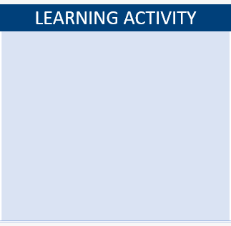
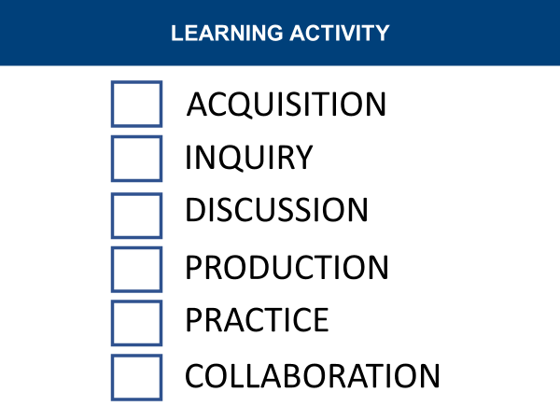
Story board
Start page
Story board
  Structure
  Content
  Learning activities
    Paper: tick off the learning activities of that section on a learning activity card
    PowerPoint: drag the learning activities to the learning activity field

Slide 32
THEORETICAL
PRACTICAL
History
Old Methods
Week 1
Week 5
Week 2
Variation
New Methods
Week 6
Change
Advanced New Methods
Week 3
Week 7
Implications
Research paper
Week 4
c
Week 8
Notes:
Add the learning activity cards for each part.

Slide 33

THEORETICAL
PRACTICAL
History
Old Methods
Week 1
Week 5
Week 2
Variation
New Methods
Week 6
Change
Advanced New Methods
Week 3
Week 7
Implications
Research paper
Week 4
c
Week 8
Notes:
Tick off the learning activities of that section on a learning activity card.

Slide 34
Story board
BUILDING BLOCKS
CONTENT |  | LEARNING ACTIVITY | SKILLS
…
ACQUISITION
ACQUISITION
INQUIRY
INQUIRY
DISCUSSION
DISCUSSION
PRODUCTION
…
PRODUCTION
PRACTICE
PRACTICE
COLLABORATION
COLLABORATION
KNOWLEDGE
KNOWLEDGE
COMMUNICATION
CONTENT |  | LEARNING ACTIVITY | SKILLS
COMMUNICATION
…
LANGUAGE
LANGUAGE
PROJECT
PROJECT
CREATIVITY
CREATIVITY
INTERCULTURALITY
…
INTERCULTURALITY
c
i
i
i
i
i
i
i
i
Notes:
Drag the learning activities to the learning activity field.

Slide 35
Story board
BUILDING BLOCKS
CONTENT |  | LEARNING ACTIVITY | SKILLS
Theory: week 1
ACQUISITION
ACQUISITION
INQUIRY
INQUIRY
ACQUISITION
DISCUSSION
DISCUSSION
PRODUCTION
History
PRODUCTION
PRACTICE
PRACTICE
COLLABORATION
COLLABORATION
KNOWLEDGE
KNOWLEDGE
COMMUNICATION
CONTENT |  | LEARNING ACTIVITY | SKILLS
COMMUNICATION
Theory: week 2
LANGUAGE
LANGUAGE
PROJECT
PROJECT
ACQUISITION
CREATIVITY
CREATIVITY
INQUIRY
INTERCULTURALITY
Variation
INTERCULTURALITY
c
i
i
i
i
i
i
i
i

Slide 36
Story board
BUILDING BLOCKS
CONTENT |  | LEARNING ACTIVITY | SKILLS
Theory: week 3
ACQUISITION
ACQUISITION
INQUIRY
INQUIRY
ACQUISITION
DISCUSSION
DISCUSSION
PRODUCTION
Change
PRODUCTION
INQUIRY
PRACTICE
PRACTICE
DISCUSSION
COLLABORATION
COLLABORATION
KNOWLEDGE
KNOWLEDGE
COMMUNICATION
CONTENT |  | LEARNING ACTIVITY | SKILLS
COMMUNICATION
Theory: week 4
LANGUAGE
LANGUAGE
PROJECT
PROJECT
DISCUSSION
CREATIVITY
CREATIVITY
INTERCULTURALITY
Implications
INTERCULTURALITY
c
i
i
i
i
i
i
i
i

Slide 37
Story board
BUILDING BLOCKS
CONTENT |  | LEARNING ACTIVITY | SKILLS
Practice: week 1
ACQUISITION
ACQUISITION
INQUIRY
INQUIRY
INQUIRY
DISCUSSION
DISCUSSION
PRODUCTION
Old methods
PRODUCTION
PRODUCTION
PRACTICE
PRACTICE
PRACTICE
COLLABORATION
COLLABORATION
KNOWLEDGE
KNOWLEDGE
COMMUNICATION
CONTENT |  | LEARNING ACTIVITY | SKILLS
COMMUNICATION
Practice: week 2
LANGUAGE
LANGUAGE
PROJECT
PROJECT
PRODUCTION
CREATIVITY
CREATIVITY
INTERCULTURALITY
New methods
INTERCULTURALITY
PRACTICE
c
i
i
i
i
i
i
i
i

Slide 38
Story board
BUILDING BLOCKS
CONTENT |  | LEARNING ACTIVITY | SKILLS
Practice: week 3
ACQUISITION
ACQUISITION
INQUIRY
INQUIRY
PRODUCTION
DISCUSSION
DISCUSSION
Advanced new
methods
PRODUCTION
PRODUCTION
PRACTICE
PRACTICE
PRACTICE
COLLABORATION
COLLABORATION
KNOWLEDGE
KNOWLEDGE
COMMUNICATION
CONTENT |  | LEARNING ACTIVITY | SKILLS
COMMUNICATION
Practice: week 4
LANGUAGE
LANGUAGE
PROJECT
PROJECT
CREATIVITY
PRODUCTION
CREATIVITY
INTERCULTURALITY
Research Paper
INTERCULTURALITY
c
i
i
i
i
i
i
i
i

Slide 39
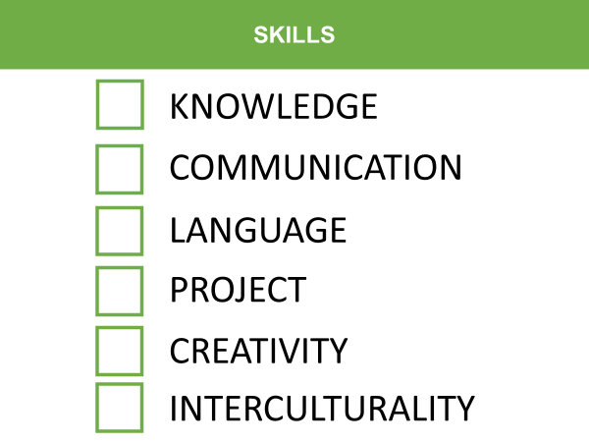
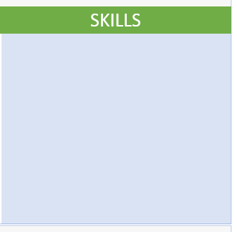
Story board
Start page
Storyboard
  Structure
  Content
  Learning activities
  Skills (both in relation to content and learning activities)
    Paper: tick off the skills of that section on a skills card
    PowerPoint: drag skills to the skills field

Slide 40
THEORETICAL
PRACTICAL
History
Old Methods
Week 1
Week 5
Week 2
Variation
New Methods
Week 6
Change
Advanced New Methods
Week 3
Week 7
Implications
Research paper
Week 4
c
Week 8
Notes:
First step is to add the skills cards.

Slide 41

THEORETICAL
PRACTICAL
History
Old Methods
Week 1
Week 5
Week 2
Variation
New Methods
Week 6
Change
Advanced New Methods
Week 3
Week 7
Implications
Research paper
Week 4
c
Week 8
Notes:
As a second step, you figure out how the content of your course contributes to the skills of the students. In this case the teachers teaches students how to deal with knowledge.

Slide 42
THEORETICAL
PRACTICAL
History
Old Methods
Week 1
Week 5
Week 2
Variation
New Methods
Week 6
Change
Advanced New Methods
Week 3
Week 7
Implications
Research paper
Week 4
c
Week 8
Notes:
Third, you consider how the learning activities contribute to students' skills. In this case, that week's discussion with a large group of students from different backgrounds contributes to students' communication skills and interculturalism skills.

Slide 43
THEORETICAL
PRACTICAL
History
Old Methods
Week 1
Week 5
Week 2
Variation
New Methods
Week 6
Change
Advanced New Methods
Week 3
Week 7
C
Research paper
Implications
LA
Week 4
c
Week 8
LA
Notes:
If you would like to keep track of where those skills come from (i.e., whether they come from the content or the learning activities), you can add that with pen.

Slide 44
THEORETICAL
PRACTICAL
History
Old Methods
Week 1
Week 5
Week 2
Variation
New Methods
Week 6
Change
Advanced New Methods
Week 3
Week 7
C
Research paper
Implications
LA
Week 4
c
Week 8
LA
Notes:
This is what it looks like for all the parts.

Slide 45
Story board
BUILDING BLOCKS
CONTENT |  | LEARNING ACTIVITY | SKILLS
…
ACQUISITION
ACQUISITION
INQUIRY
INQUIRY
DISCUSSION
DISCUSSION
PRODUCTION
…
PRODUCTION
PRACTICE
PRACTICE
COLLABORATION
COLLABORATION
KNOWLEDGE
KNOWLEDGE
COMMUNICATION
CONTENT |  | LEARNING ACTIVITY | SKILLS
COMMUNICATION
…
LANGUAGE
LANGUAGE
PROJECT
PROJECT
CREATIVITY
CREATIVITY
INTERCULTURALITY
…
INTERCULTURALITY
c
i
i
i
i
i
i
i
i
Notes:
Drag the skills to the skills field.

Slide 46
Story board
BUILDING BLOCKS
CONTENT |  | LEARNING ACTIVITY | SKILLS
Theory: week 1
ACQUISITION
ACQUISITION
INQUIRY
INQUIRY
ACQUISITION
KNOWLEDGE
DISCUSSION
DISCUSSION
PRODUCTION
History
LANGUAGE
PRODUCTION
PRACTICE
PRACTICE
INTERCULTURALITY
COLLABORATION
COLLABORATION
KNOWLEDGE
KNOWLEDGE
COMMUNICATION
CONTENT |  | LEARNING ACTIVITY | SKILLS
COMMUNICATION
Theory: week 2
LANGUAGE
LANGUAGE
PROJECT
PROJECT
ACQUISITION
KNOWLEDGE
CREATIVITY
CREATIVITY
INQUIRY
LANGUAGE
INTERCULTURALITY
Variation
INTERCULTURALITY
c
i
i
INTERCULTURALITY
i
i
i
i
i
i

Slide 47
Story board
BUILDING BLOCKS
CONTENT |  | LEARNING ACTIVITY | SKILLS
Theory: week 3
ACQUISITION
ACQUISITION
INQUIRY
INQUIRY
ACQUISITION
KNOWLEDGE
DISCUSSION
DISCUSSION
PRODUCTION
Change
PRODUCTION
INQUIRY
LANGUAGE
PRACTICE
PRACTICE
DISCUSSION
INTERCULTURALITY
COLLABORATION
COLLABORATION
KNOWLEDGE
KNOWLEDGE
COMMUNICATION
CONTENT |  | LEARNING ACTIVITY | SKILLS
COMMUNICATION
Theory: week 4
LANGUAGE
LANGUAGE
PROJECT
PROJECT
COMMUNICATION
DISCUSSION
CREATIVITY
CREATIVITY
INTERCULTURALITY
INTERCULTURALITY
Implications
INTERCULTURALITY
c
i
i
i
i
KNOWLEDGE
i
i
i
i

Slide 48
Story board
BUILDING BLOCKS
CONTENT |  | LEARNING ACTIVITY | SKILLS
Practice: week 1
ACQUISITION
ACQUISITION
INQUIRY
INQUIRY
INQUIRY
DISCUSSION
KNOWLEDGE
DISCUSSION
PRODUCTION
Old methods
PRODUCTION
PRODUCTION
PROJECT
PRACTICE
PRACTICE
PRACTICE
COLLABORATION
COLLABORATION
KNOWLEDGE
KNOWLEDGE
COMMUNICATION
CONTENT |  | LEARNING ACTIVITY | SKILLS
COMMUNICATION
Practice: week 2
LANGUAGE
LANGUAGE
PROJECT
PROJECT
PRODUCTION
KNOWLEDGE
CREATIVITY
CREATIVITY
INTERCULTURALITY
New methods
LANGUAGE
INTERCULTURALITY
PRACTICE
c
i
i
i
i
PROJECT
i
i
i
i

Slide 49
Story board
BUILDING BLOCKS
CONTENT |  | LEARNING ACTIVITY | SKILLS
Practice: week 3
ACQUISITION
ACQUISITION
INQUIRY
INQUIRY
PRODUCTION
KNOWLEDGE
DISCUSSION
DISCUSSION
Advanced new
methods
PRODUCTION
PRODUCTION
PRACTICE
LANGUAGE
PRACTICE
PRACTICE
PROJECT
COLLABORATION
COLLABORATION
KNOWLEDGE
KNOWLEDGE
COMMUNICATION
CONTENT |  | LEARNING ACTIVITY | SKILLS
COMMUNICATION
Practice: week 4
LANGUAGE
LANGUAGE
PROJECT
KNOWLEDGE
PROJECT
CREATIVITY
PRODUCTION
CREATIVITY
COMMUNICATION
INTERCULTURALITY
Research Paper
INTERCULTURALITY
LANGUAGE
c
i
i
i
i
PROJECT
i
i
i
i

Slide 50
Story board
Start page
Story board
  Structure
  Content
  Learning activities
  Communication
    WHEN will you inform students?
    ABOUT WHAT will you inform students?
    (HOW?)
Notes:
Lastly, we also want you to start thinking about communicating about the skills. There is no right or wrong way to do this and it can be tailored entirely according to personal preference.
We'd like you to think about today:
WHEN do you inform your students. For example, you can talk about this at the beginning or end of the course, or during a particular lecture where it is relevant.
WHAT are you informing your students about? You can give them an overview of all the skills in your course or section, but perhaps you want to talk about what skills you are not teaching them, or draw their attention to the importance of the skills on the job market? While communicating about these skills, do whatever you feel comfortable with.
HOW? We unfortunately don't have time in this workshop to think about how you can practically integrate the communication into your course. We do have a lot of ideas and tips and tricks for this, which you can discover in the knowledge clip that you will receive after the workshop.

Slide 51
THEORETICAL
PRACTICAL
History
Old Methods
Week 1
Week 5
Week 2
Variation
New Methods
Week 6
Change
Advanced New Methods
Week 3
Week 7
C
Research paper
Implications
LA
Week 4
c
Week 8
LA
Notes:
In the paper version, you add the information circles on the story board when you think it is relevant.

Slide 52
THEORETICAL
PRACTICAL
i
i
History
Old Methods
Week 1
Week 5
Week 2
Variation
New Methods
Week 6
Change
Advanced New Methods
Week 3
Week 7
C
Research paper
Implications
LA
Week 4
c
Week 8
LA
i
Notes:
That looks like this for instance. This teacher chose to talk about it at the beginning and at the end of his course, as well as during the first lesson about the practical part of his course.

Slide 53
Story board
BUILDING BLOCKS
CONTENT |  | LEARNING ACTIVITY | SKILLS
…
ACQUISITION
ACQUISITION
INQUIRY
INQUIRY
DISCUSSION
DISCUSSION
PRODUCTION
…
PRODUCTION
PRACTICE
PRACTICE
COLLABORATION
COLLABORATION
KNOWLEDGE
KNOWLEDGE
COMMUNICATION
CONTENT |  | LEARNING ACTIVITY | SKILLS
COMMUNICATION
…
LANGUAGE
LANGUAGE
PROJECT
PROJECT
CREATIVITY
CREATIVITY
INTERCULTURALITY
…
INTERCULTURALITY
c
i
i
i
i
i
i
i
i
Notes:
In the PowerPoint you the information circles by dragging them.

Slide 54
Story board
BUILDING BLOCKS
CONTENT |  | LEARNING ACTIVITY | SKILLS
Theory: week 1
ACQUISITION
ACQUISITION
i
INQUIRY
INQUIRY
ACQUISITION
KNOWLEDGE
DISCUSSION
DISCUSSION
PRODUCTION
History
LANGUAGE
PRODUCTION
PRACTICE
PRACTICE
INTERCULTURALITY
COLLABORATION
COLLABORATION
KNOWLEDGE
KNOWLEDGE
COMMUNICATION
CONTENT |  | LEARNING ACTIVITY | SKILLS
COMMUNICATION
Theory: week 2
LANGUAGE
LANGUAGE
PROJECT
PROJECT
ACQUISITION
KNOWLEDGE
CREATIVITY
CREATIVITY
INQUIRY
LANGUAGE
INTERCULTURALITY
Variation
INTERCULTURALITY
c
i
i
INTERCULTURALITY
i
i
i
i
i
i

Slide 55
Story board
BUILDING BLOCKS
CONTENT |  | LEARNING ACTIVITY | SKILLS
Theory: week 3
ACQUISITION
ACQUISITION
INQUIRY
INQUIRY
ACQUISITION
KNOWLEDGE
DISCUSSION
DISCUSSION
PRODUCTION
Change
PRODUCTION
INQUIRY
LANGUAGE
PRACTICE
PRACTICE
DISCUSSION
INTERCULTURALITY
COLLABORATION
COLLABORATION
KNOWLEDGE
KNOWLEDGE
COMMUNICATION
CONTENT |  | LEARNING ACTIVITY | SKILLS
COMMUNICATION
Theory: week 4
LANGUAGE
LANGUAGE
PROJECT
PROJECT
COMMUNICATION
DISCUSSION
CREATIVITY
CREATIVITY
INTERCULTURALITY
INTERCULTURALITY
Implications
INTERCULTURALITY
c
i
i
i
i
KNOWLEDGE
i
i
i
i

Slide 56
Story board
BUILDING BLOCKS
CONTENT |  | LEARNING ACTIVITY | SKILLS
Practice: week 1
ACQUISITION
ACQUISITION
i
INQUIRY
INQUIRY
INQUIRY
DISCUSSION
KNOWLEDGE
DISCUSSION
PRODUCTION
Old methods
PRODUCTION
PRODUCTION
PROJECT
PRACTICE
PRACTICE
PRACTICE
COLLABORATION
COLLABORATION
KNOWLEDGE
KNOWLEDGE
COMMUNICATION
CONTENT |  | LEARNING ACTIVITY | SKILLS
COMMUNICATION
Practice: week 2
LANGUAGE
LANGUAGE
PROJECT
PROJECT
PRODUCTION
KNOWLEDGE
CREATIVITY
CREATIVITY
INTERCULTURALITY
New methods
LANGUAGE
INTERCULTURALITY
PRACTICE
c
i
i
i
i
PROJECT
i
i
i
i

Slide 57
Story board
BUILDING BLOCKS
CONTENT |  | LEARNING ACTIVITY | SKILLS
Practice: week 3
ACQUISITION
ACQUISITION
INQUIRY
INQUIRY
PRODUCTION
KNOWLEDGE
DISCUSSION
DISCUSSION
Advanced new
methods
PRODUCTION
PRODUCTION
PRACTICE
LANGUAGE
PRACTICE
PRACTICE
PROJECT
COLLABORATION
COLLABORATION
KNOWLEDGE
KNOWLEDGE
COMMUNICATION
CONTENT |  | LEARNING ACTIVITY | SKILLS
COMMUNICATION
Practice: week 4
i
LANGUAGE
LANGUAGE
PROJECT
KNOWLEDGE
PROJECT
CREATIVITY
PRODUCTION
CREATIVITY
COMMUNICATION
INTERCULTURALITY
Research Paper
INTERCULTURALITY
LANGUAGE
c
i
i
i
i
PROJECT
i
i
i
i

Slide 58
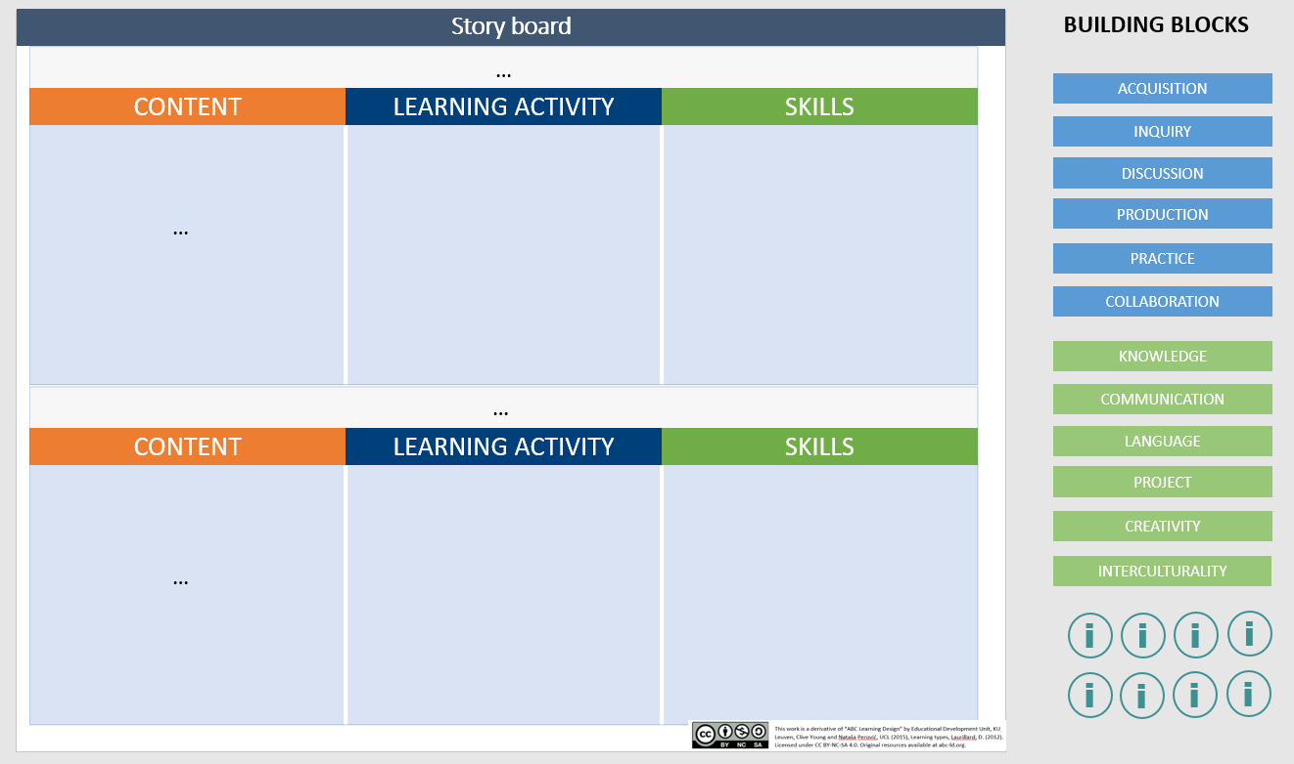
Notes:
In the PowerPoint you the information circles by dragging them.

Slide 59

Notes:
The facilitator shares the accompanying PowerPoint via the screen to explain the action plan. At the end of the storyboard, it is time for the teachers to reach a conclusion. We therefore ask teachers to fill in the action plan. By doing so, they should think specifically about the steps they still need to take, when they will do it, and who will do it. For example, they may have an assistant or educational support person who can help them do this.

Slide 60
Action plan
Some guiding questions:
What actions are needed?
Does the storyboard need further refinement, or can implementation be considered?
What steps are needed to achieve implementation? Do you need support with this? If so, which?
What actions are needed to communicate the skills in the profession?
What is a first concrete step?
Who will/can you involve in this process?

Slide 61
Action Plan
Action | Timing | Who?

Slide 62

Notes:
The facilitators thank the participants for their participation and they remind the participants to sign the attendance sheet before leaving.
It is also helpful to get feedback from teachers about the workshop, so you know what went well and what didn't go so well. Some questions to ask:
Did this workshop help you reflect on the way you teach Humanities skills to your students? Answer Yes/No, and provide some more context if you like.
Do you plan to modify your course design(s) based on this workshop? Answer Yes/No, and provide some more context if you wish.
Overall, my assessment of the workshop is very negative - positive.
What could be improved in the workshop?
What would you definitely leave unchanged in the workshop?
We ask these questions using PollEverywhere. With that tool, they answer the questions online, which are then projected on the screen. So with each question, you can see the answers right away and you can go into it to make it a group discussion.

