Slide 1






Slide 2


Slide 3

Start page: step 1
1a. INFORMATION COURSE
1b. CONTENT
Program
Name course
Teachers
Workshop date
…
…
Summary course:
…
…
@asset_h
…

Slide 4
Start page: step 2
2. LEARNING ACTIVITIES
Order the learning activities below, going from 1 (“This learning activity is used the most in this course”) to 6 (“This learning activity is used the least in this course”). You can also add multiple activities for one number if there is a tie.
1.
2.
3.
4.
5.
6.

Slide 5
Start page: step 3 – survey skills
In this survey, we will present you with 5 statements per skills cluster. For each of the statements, please indicate whether your course offers this to students. For each cluster you can indicate how often you answered "yes". At the end of the survey, you can visualize this with the help of the graph on slide 11.
Knowledge
My course teaches students to easily find reliable sources of information | yes/no
My course teaches students to efficiently distil the essence of information | yes/no
My course teaches students to analyze concrete facts on an abstract level | yes/no
My course teaches students to easily reduce large amounts of information to a coherent, concise whole | yes/no
My course teaches students to explain matters in such a way that their audience knows what the most important points are | yes/no
/5
…

Slide 6
Start page: step 3 – survey skills
Communication
My course teaches students to work well as part of a team because they can communicate well with others | yes/no
My course teaches students to select an appropriate channel through which to communicate their message | yes/no
My course teaches students to give relevant feedback to the people around them, with the aim of achieving a positive collaboration | yes/no
My course teaches students to develop strategies to achieve optimal communication in a professional context | yes/no
My course teaches students to communicate a message in an appealing way | yes/no
…
/5

Slide 7
Start page: step 3 – survey skills
Language
My course teaches students to understand the composition and structure of at least one language | yes/no
My course teaches students to think in abstract terms about linguistic structures | yes/no
My course teaches students to pay attention to how language is used in day-to-day life | yes/no
My course teaches students to pay attention to the way in which language varies, functions and changes in their surroundings | yes/no
My course teaches students to can translate accurately from a source language into a target language | yes/no
…
/5

Slide 8
Start page: step 3 – survey skills
Project
My course teaches students to work towards a deadline in such a way as to meet that deadline | yes/no
My course teaches students to work efficiently | yes/no
My course teaches students to manage their own workload when working on a project over a long period (e.g. several months) | yes/no
My course teaches students to set their own goals | yes/no
My course teaches students to retain a clear overview when working on multiple tasks at the same time | yes/no
…
/5

Slide 9
Start page: step 3 – survey skills
Creativity
My course teaches students to be artistic | yes/no
My course teaches students to be a creative thinker | yes/no
My course teaches students to be very imaginative | yes/no
My course teaches students to think out of the box to come up with new ideas | yes/no
My course teaches students to develop a project creatively | yes/no
…
/5

Slide 10
Start page: step 3 – survey skills
Interculturality
My course teaches students to interpret facts in their cultural context | yes/no
My course teaches students to realise that things are not just black and white: that they can also think in shades of grey | yes/no
My course teaches students to reflect on the similarities and differences between human behaviours and expressions from a variety of eras, regions and cultures | yes/no
My course teaches students to reflect on social diversity in a nuanced way | yes/no
My course teaches students to be open to other people’s ways of thinking | yes/no
…
/5

Slide 11
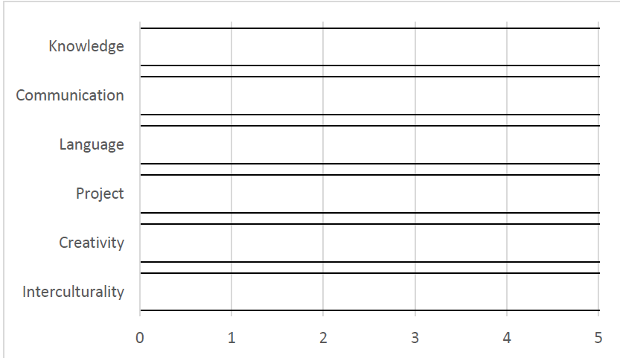
Start page: step 3 – graph skills
3. Skills
Visualize the results of the skills survey with the help of the graph.

Slide 12


Slide 13
Story board
BUILDING BLOCKS
CONTENT |  | LEARNING ACTIVITY | SKILLS
…
ACQUISITION
ACQUISITION
INQUIRY
INQUIRY
DISCUSSION
DISCUSSION
PRODUCTION
…
PRODUCTION
PRACTICE
PRACTICE
COLLABORATION
COLLABORATION
KNOWLEDGE
KNOWLEDGE
COMMUNICATION
CONTENT |  | LEARNING ACTIVITY | SKILLS
COMMUNICATION
…
LANGUAGE
LANGUAGE
PROJECT
PROJECT
CREATIVITY
CREATIVITY
INTERCULTURALITY
…
INTERCULTURALITY
i
i
i
i
i
i
i
i

Slide 14


Slide 15
Action Plan
Action | Timing | Who?

